Slide 1
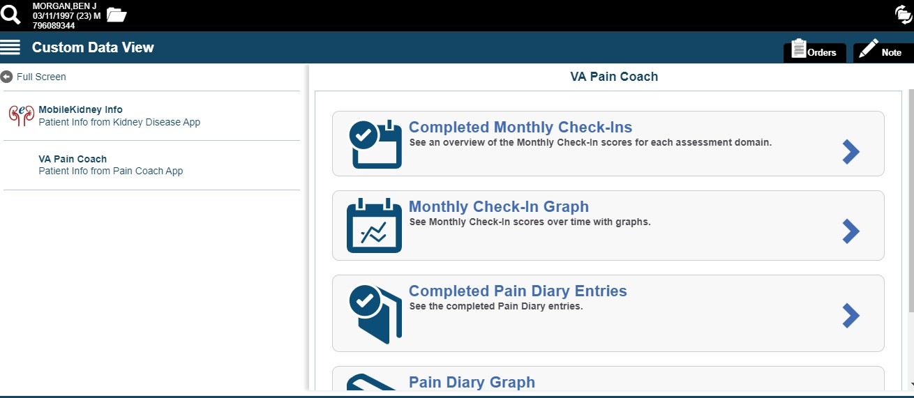
Virtual Care Manager 2.1 - Patient Generated Data
VCM 2.1 will display patient generated data similar to Patient Viewer.
Additional data will include Vitals from Connected Health devices

Slide 2
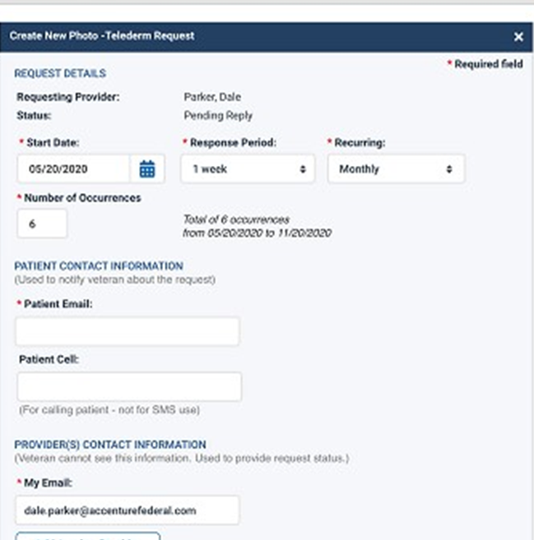
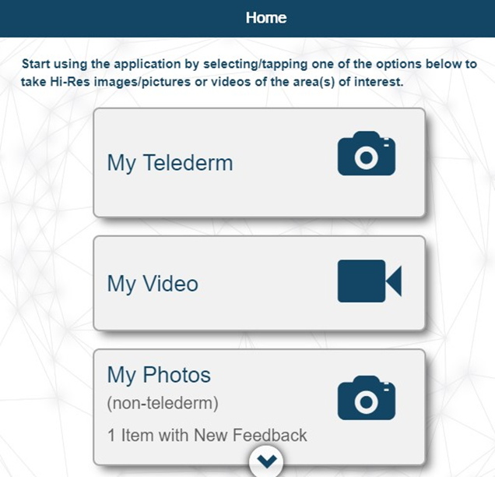
My VA Images
Staff-Facing My VA Images
Patient-Facing My VA Images

Slide 3
Mental Health Checkup
Mental Health Checkup allow a provider to order a mental health assessment to be completed by a patient in a remote location and then the completed assessment is sent into Vista’s Mental Health Assistant application
Full Name | Est Release
Generalized Anxiety Disorder, 7 items | Complete
PCL-5 | Complete
Brief Resiliency Scale | Complete
Insomnia Severity Index | Complete
World Health Organization Disability Assessment Schedule 2.0 - 12-item | Complete
Patient Health Questionnaire Depression Scale | Jul-20
Brief Addiction Monitor - IOP version | Jul-20
Brief Addiction Monitor - Revised | Jul-20
Working Alliance Inventory-Short Revised | Jul-20
Short Warwick-Edinburgh Scale | Jul-20
Veterans RAND 12 Item Health Survey | Jul-20
World Health Organization Quality of Life - WHOQOL-BREF | Jul-20
Mental Health Recovery Measure – 10 item | Jul-20

Slide 4
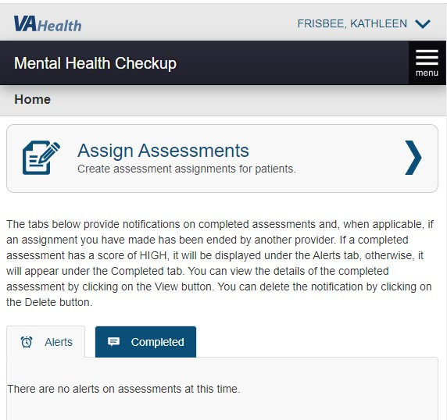
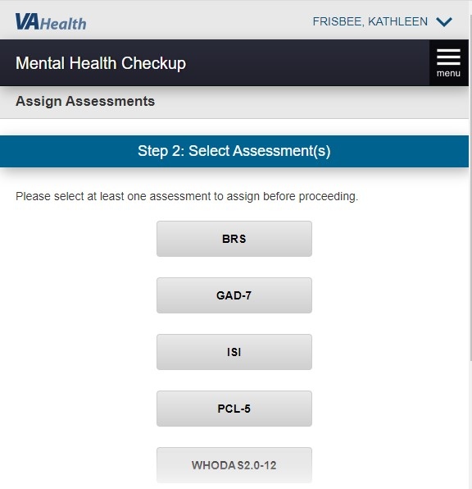
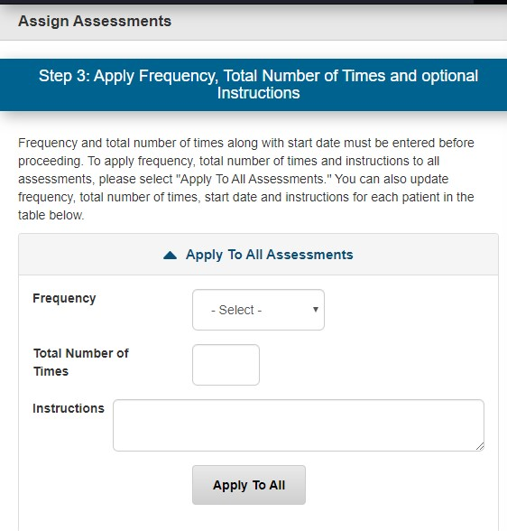
Provider View of Mental Health Checkup

Slide 5
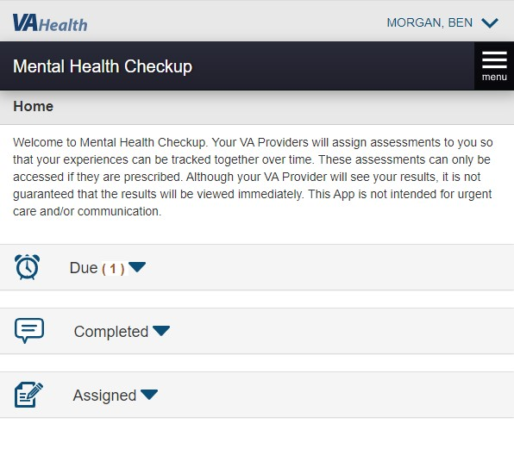
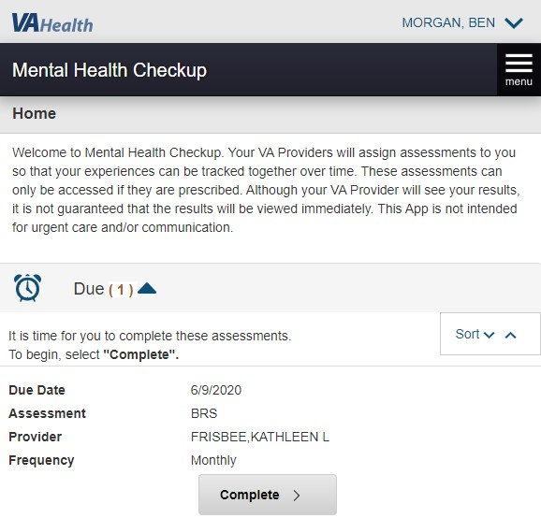
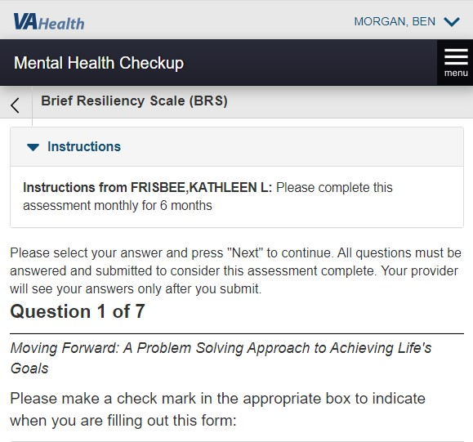
Patient View of Mental Health Checkup

